Slide 1
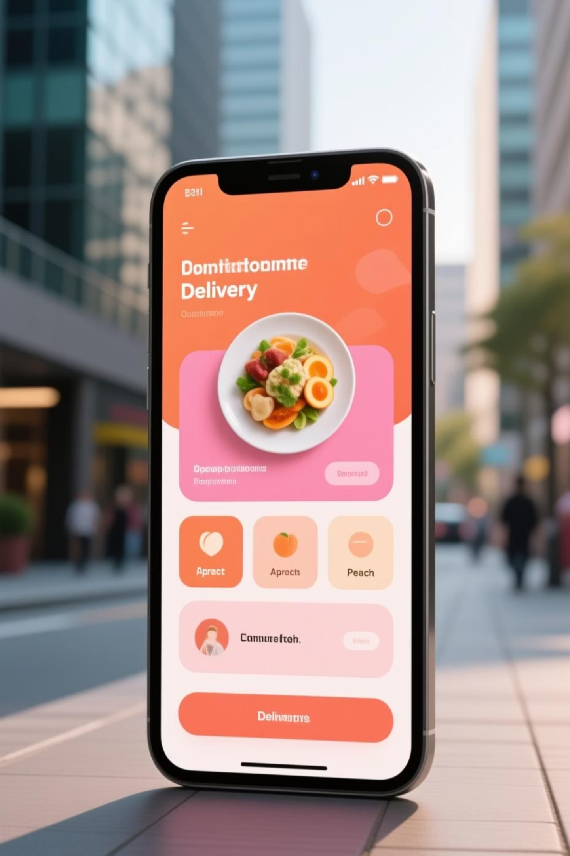
Swiggy Food Delivery Performance Analysis
A comprehensive analytics project examining 10,000 orders to uncover insights on customer behavior, restaurant performance, delivery efficiency, and revenue optimization using Python, SQL, and Power BI.

Slide 2

Project Objectives
Customer Patterns
Delivery Performance
Study demand across cities, cuisines, segments, and peak hours
Analyze speed, distance impact, and partner efficiency
Restaurant Analysis
Coupon Impact
Identify top performers and cuisine popularity trends
Evaluate offer effectiveness and customer retention
Build a comprehensive 4-page Power BI dashboard to generate actionable insights for optimizing operations.

Slide 3

Dataset & Methodology
10,000 Orders Analyzed
Analytics Toolkit
Python: Data cleaning, EDA, feature engineering
Core Fields: Order details, delivery metrics, restaurant info, ratings, and customer data
SQL: Operational analytics, revenue insights, segmentation
Extended Fields: Customer segments, membership status, coupon usage, platform fees, and delay indicators
Power BI: Interactive dashboards and storytelling

Slide 4

Customer Behavior Insights
1PM & 8PM
25%
45%+
Peak Hours
Swiggy One Impact
Premium Revenue
Highest order volumes during lunch and dinner
Members order more frequently than regular users
Premium segment drives nearly half of total revenue
Most active cities include Mumbai, Delhi, and Bangalore, with the Regular customer segment showing highest activity. Evening peak (7-9 PM) generates maximum orders.

Slide 5
Restaurant & Cuisine Performance
Fast Food Dominance
Italian Favorites
Biryani High-Value
Top cuisine category with consistent high order volumes
Second most popular cuisine with strong customer preference
Dominates high-value orders with premium pricing
Cloud Kitchens deliver 10-15 minutes faster than Dine-in outlets. Some restaurants consistently cause delays due to high prep times.

Slide 6



Delivery Performance Analysis
95%
70%
Top Partners
Low Performers
Best delivery partners achieve on-time delivery excellence
Slowest partners drop to concerning delivery rates
Key Findings
Average delivery time: 25-45 minutes
Orders above 6 km have significantly higher delays
Distance and prep time strongly influence delays
Partner performance variance up to 20 minutes

Slide 7




Coupon & Offer Impact
35-40% Usage
Volume Boost
Value Reduction
Orders utilize coupon codes
Coupons increase order count
But lower average order value
"NEW50" coupon attracts high first-order conversions, while regular discounts improve retention for Budget customers.

Slide 8

Power BI Dashboard Overview
01
Executive Overview
High-level KPIs, order trends, and revenue summary
02
Customer & Revenue
Segment analysis, membership impact, spending patterns
03
Delivery Operations
Partner performance, delay analysis, distance metrics
04
Restaurant Insights
Cuisine popularity, prep times, rating distributions
A comprehensive 4-page interactive dashboard enabling stakeholders to explore data, identify trends, and make informed decisions.

Slide 9
Strategic Recommendations
Operational
Customer Strategy
Prioritize top delivery partners for long distances
Personalized discounts for Budget segment
Alert restaurants with high prep times
Promote Swiggy One to frequent users
Optimize routes for orders above 6 km
Introduce loyalty rewards for repeat customers
Restaurant Focus
Offer Optimization
Promote best-rated restaurants in app carousel
Reduce high discounts for Premium customers
Reduce prep time for high-demand cuisines
Target coupons for non-repeat customers
Identify low performers for improvement
Promote limited-time offers during peak hours

Slide 10


Project Impact & Conclusion
Key Achievements
This end-to-end analytics solution demonstrates how data-driven insights can transform food delivery operations. The project showcases:
Complete analytics workflow from cleaning to visualization
Actionable insights for business decision-making
Professional-grade data storytelling skills
Operational efficiency improvements
Business Value: Critical insights on customer behavior, delivery performance, restaurant efficiency, and revenue optimization support strategic decision-making and improve operational efficiency across the platform.

